Slide 1

Student Attendance Tracking
Group B - Code Green
Sirisha Vanamali
Rohith Babu sadhu
Sri Sai Ram Kumar Mamidala
Vamsi Devalla
Subba Reddy Pothireddy
Vipul Reddy Madadi
Shankar Rao Vallapurapu

Slide 2
Contents
Problem Statement
Possible Solutions
Project Briefing
Requirements
Use case
Architecture
Project Management Plan
Security
Challenges
Strategy
Conclusion

Slide 3
Problem Statement
We want to develop a system which makes the life of an instructor easy in terms of tracking the attendance of a student with minimum effort.
Today, we are using different traditional ways which have certain limitations, ignoring them would make people easier to abuse them.
We will be using the QR codes for tracking the attendance of the students.

Slide 4
Introduction
Develop a System which would help the professors easy to grade and track the students attendance.
Develop a system which could overcome all the litigations of the previous systems.
Instructor develops a unique QR for every class and students scan those QR to mark their attendance for that class.
Student can view, mark and also track his attendance.

Slide 5
Possible Solutions
Generation of multiple QR codes and capturing it for security.
QR code with IP address.
Grading the Attendance using the Two way authentication.
Generation of QR code along with tracking the students location with GPS.

Slide 6
Project Briefing
Three Users of the system
Instructor
Student
Admin
Additional Features
Students can view attendance for all courses registered
Feedback for the student and professor

Slide 7
Requirements
Student Requirements:
Student must be able to Scan the QR code.
Must be able to capture the QR code.
Student should be able to view the courses he is registered and also be able to check his attendance percentage for the respective courses.
System should provide an acknowledge stating if the QR was scanned and attendance has been marked successfully.

Slide 8
Requirements (Contd…)
Instructor Requirements:
System should allow the instructor to generate the QR code.
Generate QR code uniquely every time the instructor asks for a QR code.
System should generate the QR based on the constraints such as
Course CRN
Time at which the course meet
System should allow the instructor to display any number of QR codes.
Display the Student details.

Slide 9
Requirements (Contd…)
Admin Requirements
Requirements of the admins are likely to be overlapping with the instructor
Admin has all the features similar to that of an instructor yet has an extra feature to view the details of the instructors and the students of that particular department.

Slide 10







Tools and Technologies
Visio
NetBeans
X-Code
StarUML
Moqups
GitHub
Google tools

Slide 11
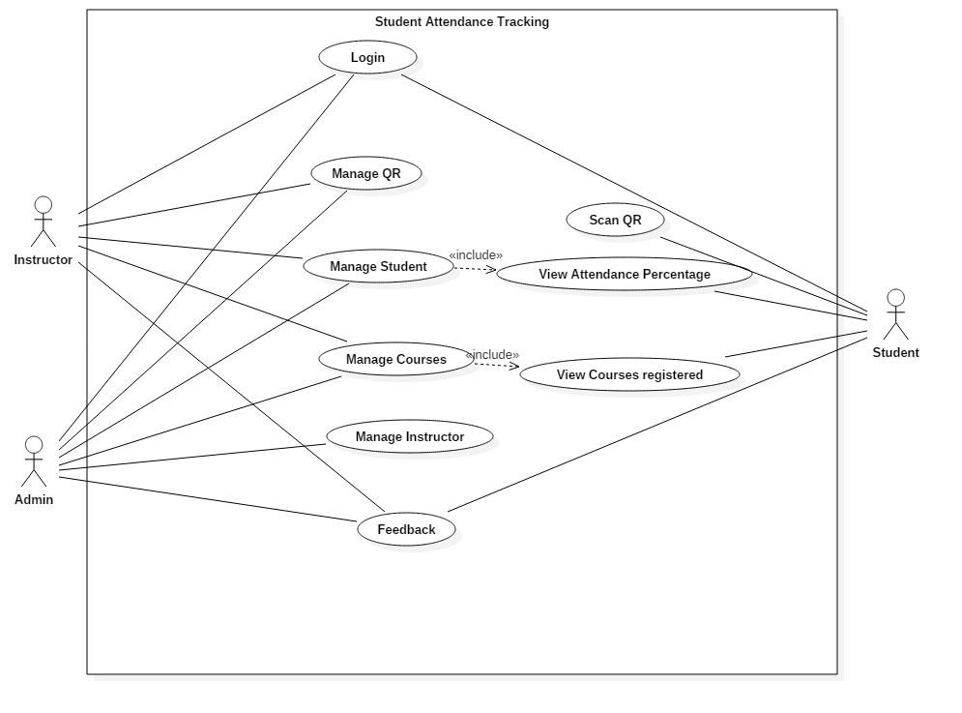
Use Case Diagram

Slide 12
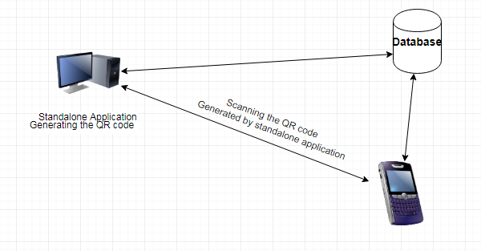
Architecture
Retrieve the data from the database and upload it back to the database
Hardware Architecture

Slide 13
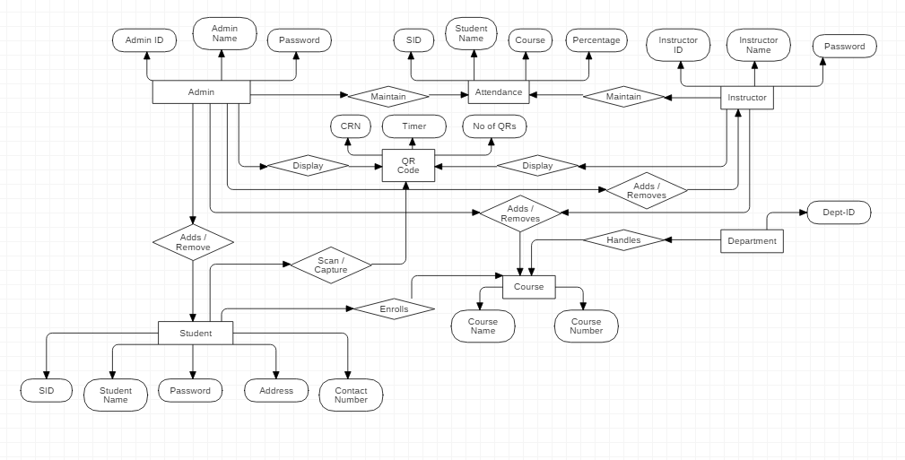
Software Architecture

Slide 14
Project Management Plan
Project Management Plan includes:
Scope Management Plan
Communication Management Plan
Cost management plan
Schedule management plan
Quality Management plan
Risk Management plan

Slide 15
Security
Student needs to login into his application before scanning the QR.
Time constraint to re-login into his account if once logged-out.
Capturing of the QR code ensures that the student is present at the time of scanning the QR.

Slide 16
Challenges
Generation of the Unique QR code for each time.
Using the constraints such as unique CRN, time at which class meets.
QR codes generated from two standalone applications are different.
Using the random captcha to generate the different QR code.
Database that can connect cross platform applications for no cost.
Scanning and capturing QR code in a single functionality.

Slide 17
Strategy
Developing of a system which initially generates a QR code uniquely every time.
Scan the uniquely generated QR from a mobile device sending the details of the student scanned the QR to the professor.
Then finally work on the user interface.

Slide 18
Estimation
Our rough estimation is around 6000 lines of code
Equal distribution of tasks among team members.
Will complete the project by the end of 11 week of GDP 2.
About 5180 hours of combined team work in GDP 1 and 2.

Slide 19
Conclusion
Generating of the QR code and tracking the attendance of the students would help both the students and the instructor’s save the time.
This approach could be used by any institution for a better, flexible and an abuse free system.

Slide 20
Thank you

